Slide 1
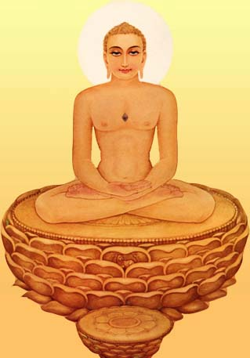
Ashtha Prakari Puja (Eight types of Puja for Tirthankar)
Compiled by : Rohit A . Shah Feb. 08 , 2002

Slide 2
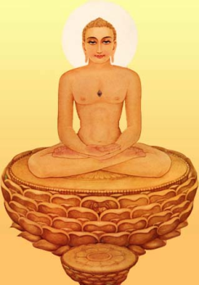
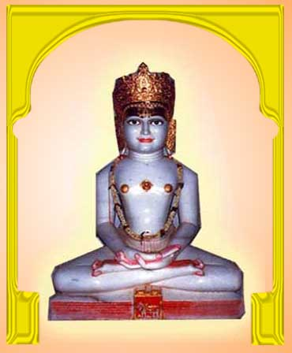
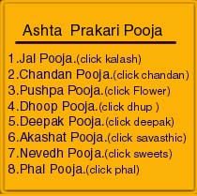
Ashtha Prakari Puja (Eight types of Puja for Tirthankar)
13
12
11
7
8
10
5
9
6
2
1
3
4
Jal
Chandan
Pushup
Dhoop
Deepak
Akshat
Nevedh
Phal

Slide 3
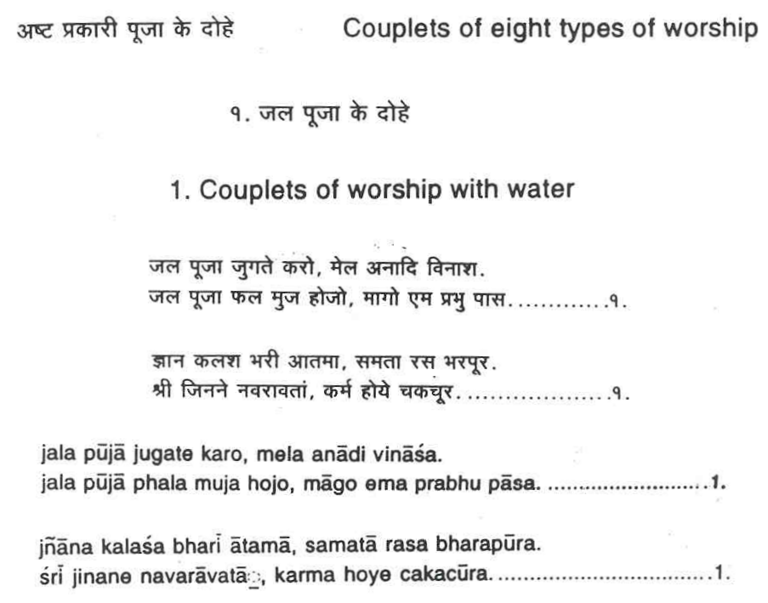
Ashtha Prakari Puja (Eight types of Puja for Tirthankar)

Slide 4
Ashtha Prakari Puja (Eight types of Puja for Tirthankar)
1. Jal Puja: (Water)
By bathing the idol in right manner we ask; may the impurities of our Karmas wash away from our soul.
Let us bathe the idol of Arihant with water in the form of equanimity, from the Kalash in the form of Knowledge; so that our Karmas get destroyed.

Slide 5
Ashtha Prakari Puja (Eight types of Puja for Tirthankar)

Slide 6
Ashtha Prakari Puja (Eight types of Puja for Tirthankar)

Slide 7
Ashtha Prakari Puja (Eight types of Puja for Tirthankar)
2. Chandan Puja: (Sandal wood)
To achieve the tranquility (coolness) in our soul, we worship the idol of Arihant with the sandalwood because tranquility resides in Arihant and his face is also tranquil.

Slide 8
Ashtha Prakari Puja (Eight types of Puja for Tirthankar)
1. Toes -

Slide 9
Ashtha Prakari Puja (Eight types of Puja for Tirthankar)
1. Toes -
Arihant, you traveled great distances by foot to preach to
the ignorant souls and show them the right path of life so his feet are worthy of worship. Let me also have that kind of strength that I can also bring righteousness for others and myself.

Slide 10
Ashtha Prakari Puja (Eight types of Puja for Tirthankar)
2. Knees -

Slide 11
Ashtha Prakari Puja (Eight types of Puja for Tirthankar)
2. Knees -
With the help of these knees you stood motionless for days in meditation and achieved omniscience. By worshiping you let me also find the strength to meditate.

Slide 12
Ashtha Prakari Puja (Eight types of Puja for Tirthankar)
3. Forearm -

Slide 13
Ashtha Prakari Puja (Eight types of Puja for Tirthankar)
3. Forearm -
Even though you had all the amenities and riches, you gave away everything with these hands, to realize your self and show the right path to mankind. All living beings were safe at your hands, as you promised them safety. By worshipping your hand, I wish I do not get attached to material wealth, and I promise non violence towards all living beings.

Slide 14
Ashtha Prakari Puja (Eight types of Puja for Tirthankar)
4. Shoulders -

Slide 15
Ashtha Prakari Puja (Eight types of Puja for Tirthankar)
4. Shoulders -
Even though you possessed the strength, you never misused it and never had pride. Your strength also carried the burden of saving others. Likewise, I wish I never become proud and I am able to carry responsibilities.

Slide 16
Ashtha Prakari Puja (Eight types of Puja for Tirthankar)
5. Head -

Slide 17
Ashtha Prakari Puja (Eight types of Puja for Tirthankar)
5. Head -
Bhagwan, you were always absorbed in self-realization and in the betterment of all living beings. Let me have the ability to think about others. Siddhashila is located on top of the universe, likewise the head is on top of the body. By worshipping the head, I want to reach Siddhashila.

Slide 18
Ashtha Prakari Puja (Eight types of Puja for Tirthankar)
6. Forehead -

Slide 19
Ashtha Prakari Puja (Eight types of Puja for Tirthankar)
6. Forehead -
Because of Tirthankar Nam-Karma, all three worlds pray to you. Worshipping your forehead will bring good fortune. You were able to equally endure pleasure and pain. I wish to do the same.

Slide 20
Ashtha Prakari Puja (Eight types of Puja for Tirthankar)
7. Neck -

Slide 21
Ashtha Prakari Puja (Eight types of Puja for Tirthankar)
7. Neck -
With your soothing and sweet speech, you touched so many lives and helped them realize their own selves. Let my speech work for the good of others.

Slide 22
Ashtha Prakari Puja (Eight types of Puja for Tirthankar)
8. Heart -

Slide 23
Ashtha Prakari Puja (Eight types of Puja for Tirthankar)
8. Heart -
Vitrag Bhagwan’s heart was full of amity, compassion, and mercy. Likewise, let my heart be full of these feelings.

Slide 24
Ashtha Prakari Puja (Eight types of Puja for Tirthankar)
9. Navel -

Slide 25
Ashtha Prakari Puja (Eight types of Puja for Tirthankar)
9. Navel -
The navel is the center for concentration of the mind during meditation. I wish to attain the highest form of meditation to realize the self, as you did. Let me have that power by worshipping this navel of yours.

Slide 26
Ashtha Prakari Puja (Eight types of Puja for Tirthankar)

Slide 27
Ashtha Prakari Puja (Eight types of Puja for Tirthankar)

Slide 28
Ashtha Prakari Puja (Eight types of Puja for Tirthankar)
3. Phool (Flower) Puja -
By offering fragrant and unbroken flower to Arihant, whose miseries have been destroyed, we acquire the capability to go to Moksha, just like the flower.

Slide 29
Ashtha Prakari Puja (Eight types of Puja for Tirthankar)

Slide 30
Ashtha Prakari Puja (Eight types of Puja for Tirthankar)
4. Dhoop Puja -
By placing the incense (dhoop) on the left side of the idol, we initiate the upward meditation to destroy the bad odor of Mithyatva (false faith) and manifest our pure soul.

Slide 31
Ashtha Prakari Puja (Eight types of Puja for Tirthankar)

Slide 32
Ashtha Prakari Puja (Eight types of Puja for Tirthankar)
5. Lamp Puja -
When we light the lamp in right manner our miseries get destroyed. As a result, we get the knowledge in the form of Kevaljnana which illuminates the whole universe.

Slide 33
Ashtha Prakari Puja (Eight types of Puja for Tirthankar)

Slide 34
Ashtha Prakari Puja (Eight types of Puja for Tirthankar)

Slide 35
Ashtha Prakari Puja (Eight types of Puja for Tirthankar)

Slide 36
Ashtha Prakari Puja (Eight types of Puja for Tirthankar)
6. Akshat Puja: (Rice)
By offering pure and unbroken rice grains in the form
of Nandavarta, we meditate in front of Arihant, keeping all our worldly attachments away.

Slide 37
Ashtha Prakari Puja (Eight types of Puja for Tirthankar)

Slide 38
Ashtha Prakari Puja (Eight types of Puja for Tirthankar)

Slide 39
Ashtha Prakari Puja (Eight types of Puja for Tirthankar)
7. Nevedh Puja -
In the course of cycle of birth and death I have remained hungry many times. But that was transitory. Oh! Arihant! give me permanent state where there is no desire of food (Moksha).

Slide 40
Ashtha Prakari Puja (Eight types of Puja for Tirthankar)

Slide 41
Ashtha Prakari Puja (Eight types of Puja for Tirthankar)
8. Phal (Fruit) Puja -
For the Puja of Arihant, the supreme being, the heavenly
gods bring fruits with devotion and as a result ask for the
Moksha, the ultimate fruit.

Slide 42
Ashtha Prakari Puja (Eight types of Puja for Tirthankar)
The End

